Slide 1
UML CLASS
DIAGRAMS
Dr. Jose Annunziato

Slide 2
Agenda
Designing Databases
Object Oriented Fundamentals
Class Diagrams
Attributes
Multiplicity
Enumerations
Generalizations
Associations
Aggregations and Compositions

Slide 3


Slide 4
Many Ways to Represent Data
There are infinite ways to represent data
Implement in high-level language (Java, C++, C#)
Document formats: XML, JSON, CSV
Spreadsheet
Relational database tables/records
Design with high-level modeling language (UML)
Need a standard across implementations: UML

Slide 5
Many Ways to Represent Data
English | Graphical (UML, ERD) | SQL | Object
Actors are cast in movies |  | create table actors ( id int; name varchar(50); primary key(id); ); create table movies ( id int; name varchar(50); primary key(id); ); create table casting ( actor_id int; movie_id int; foreign key actor_id references actors.id; foreign key movie_id references movies.id; ); | class Actor { Movie[] movies; } class Movie { Actor[] actors; }
Actor
*
casting
*
Movie

Slide 6
Designing Databases
Best approach for developing programs
Design with high-level modeling language (UML)
Implement in high-level language (Java, C++, C#)
Execute on run-time environment (JRE, CLR, ...)
Best approach for developing databases
Design with high-level modeling language (UML)
Translate to low-level language (SQL, ER model)
Execute on run-time environment (DBMS)
Both approaches start with UML
Improves compatibility between programs and databases

Slide 7
Object-Orientation Fundamentals
An object
has object identity
remains the same even when its properties change
Examples: Person, Company, Tree
A value
has no object identity
changing a value produces a different value with no connection to the previous value
Examples: 5, 3:30pm, “Hello, world!”

Slide 8
Class
Describes a collection of objects
Each class has a name
It should be a singular noun or noun phrase
Abstract classes have italicized names
Attributes are the data values of each object
Methods define the behavior
Not used in database design

Slide 9
Visually Reading a Class Diagram
Describes collection of objects
Each class has a name
singular noun or noun phrase
Abstract are italicized
Attributes are the data values of each object
Methods define the behavior
Not used in database design
Name
attribute1 : Type attribute2 : Type # attribute3 : Type attribute4 : Type
method1() : Type method2() : Type # method3() : Type method4() : Type

Slide 10
Attributes
Attributes have name, type and multiplicity
Built-in types include String, Integer, Double, Boolean, Date, Time, …
A type can also be
Another class
The same class
An enumeration
A custom datatype
Person
username : String password : String dob[0..1] : Date email : String phones[0..*] : Phone

Slide 11
Multiplicity
How many values
Written [m..n]
m is the minimum
n is the maximum
* means unlimited
Default is [1..1]
Most common:
[0..1] At most one value (optional)
[1..1] Exactly one value (mandatory)
Person
username : String password : String dob[0..1] : Date email : String phones[0..*] : Phone
[0..*] Any number of values
[1..*] At least one value

Slide 12
Enumeration
Finite (usually small) number of instances
Specified as a class with the Enumeration stereotype
Instances are called literals
<<enumeration>> MovieGenre
Horror Comedy SciFi Fantasy

Slide 13
Specialization/Generalization
AKA: Subclass/Superclass, Inheritance, Derivation
A Widget is too generic (abstract)
Also specified as “is a”, “is a kind of”, ...
<<abstract>> Widget
name : String width : Integer height : Integer
Image
width : Integer src : String
Heading
size : Integer text : Integer

Slide 14
Multivalued Attribute
Can have a set of values
Most common are:
[0..*] Any number of values
[1..*] At least one value
Indicated by using the plural with a singular
Post
title : String body : String tags [0..*] : String

Slide 15
Association
AKA: Relations, connections
Specified with a line between the two classes
Each association has two names (called roles)
The roles are verbs or verb phrases
Author
writes
is written by
Book

Slide 16
Association
Roles should allow one to form a sentence
“An Author writes a book”
“A book is written by an author”
The role is attached to the object of the sentence:
Subject (Verb Object)
Author
writes
is written by
Book

Slide 17
Association Multiplicities
Associations have multiplicities
Each end (role) has a multiplicity
Note where the multiplicity is placed:
“An author writes one or more books”
Author
writes 0..*
is written by 1..*
Book

Slide 18
Association Multiplicities
Multiplicity is usually only specified in requirements document on only one end.
It won't say
“a book is written by more than one author”
In such a case, the multiplicity will normally be [0..*]
Author
writes 0..*
is written by 1..*
Book

Slide 19
Association Multiplicities
If in doubt, then ask
“Can a book be written by more than one author?”
Don't ask
“Is the multiplicity for is written by [0..*]?”
Author
writes 0..*
is written by 1..*
Book

Slide 20
One to Many
One to many establishes that one instance might be related to many other instances
Annotate 1 on the one side and * on the many side of the association
Person
1
*
Phone

Slide 21
Many to Many
Many to many establishes that many instances might be related to many other instances
Annotate * on both ends of the association
Actor
*
*
Movie

Slide 22
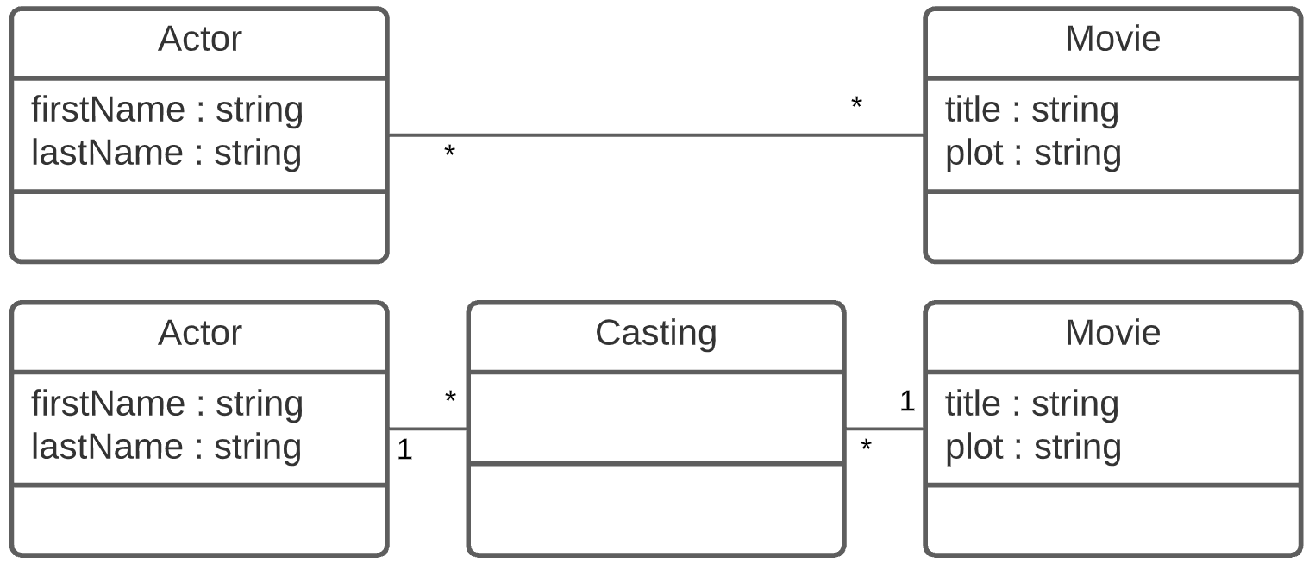
Reifying (make concrete)
Many to many relationships can't be implemented readily in SQL
Convert many to many to two 1 to many associations
New class sometimes referred to as a mapping class

Slide 23
Association Classes
Allows one to add attributes to the links of an association
It looks like a class but it is still an association
Author
writes 0..*
EditLog
edit : String date : Date
is written by 1..*
Book

Slide 24
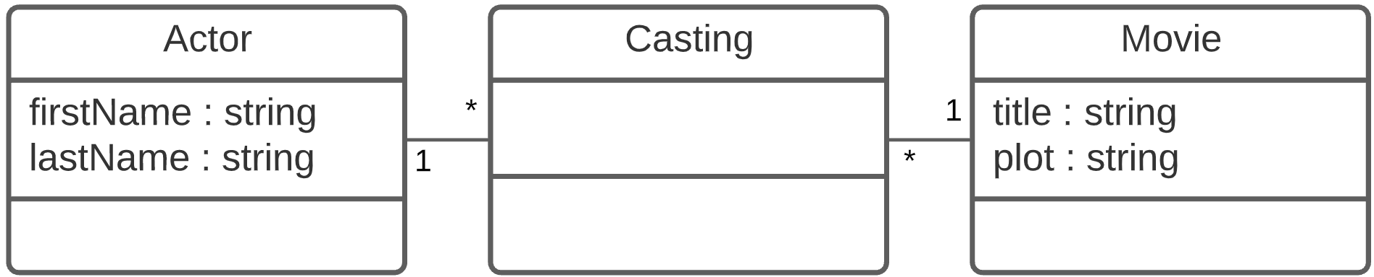
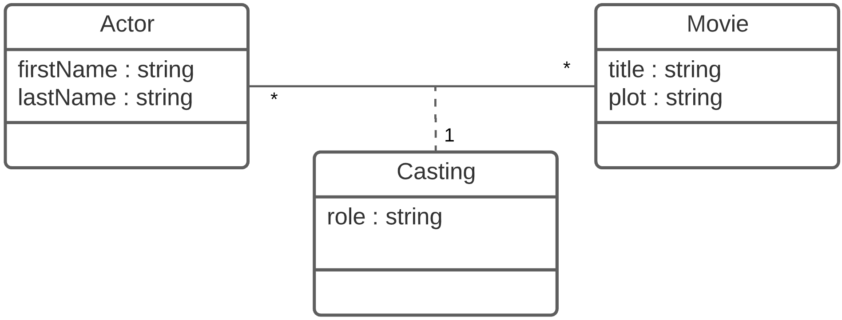
Mappings vs Associations Classes
Mapping Class
Association Class
Mapping and Association classes are many to many
Mappings only establish relation
Associations also describe relationship with added fields
added field

Slide 25
Aggregation
A page consists of widgets
A containment relationship
A widget is part of a page
Shown as an open diamond on the container end
No need to show role names
Default role names: “contains”, “part of”
Default multiplicities: [1..1], [0..*]
Post
1
0..*
Comment

Slide 26
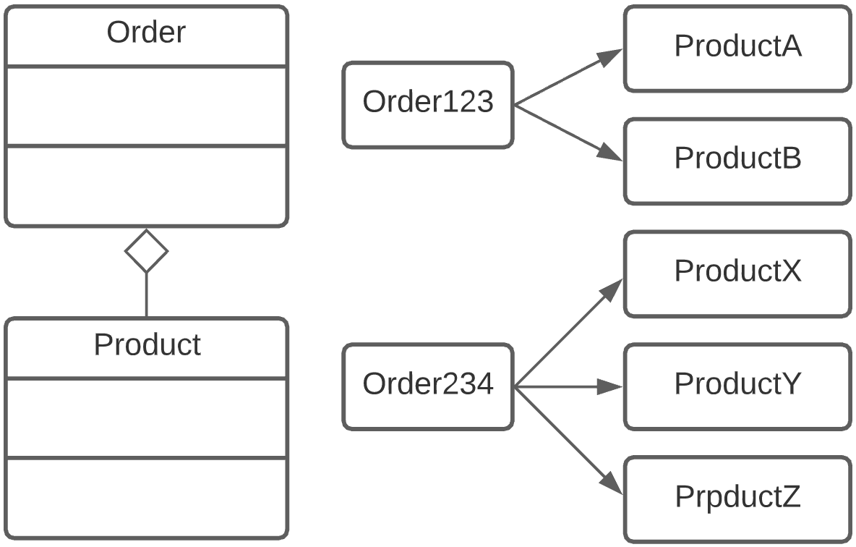
Aggregation Example
For instance consider capturing orders for products
It might not make sense to remove products even if we remove the orders
If we delete orders we keep the products

Slide 27
Composition
If lifecycle of parts depends on container, then use composition
I.e., a page is composed of widgets
If container is removed, so are the parts
Called cascading deletion
Denoted with filled in diamond
Page
1
0..*
Widget

Slide 28
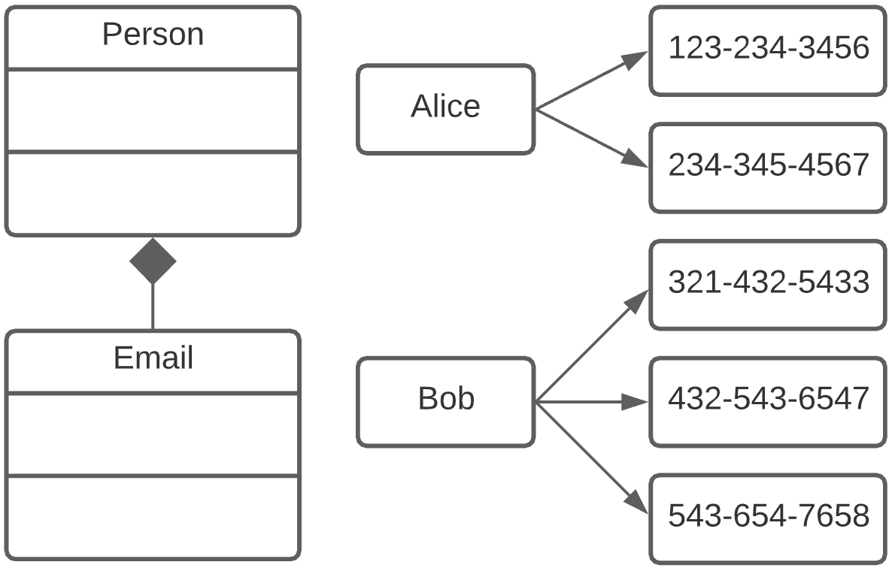
Composition Example
For instance consider capturing people's phones
It might not make sense to keep their phones around if the person doesn't exist anymore
If we delete person then also delete their phones
Phone

Slide 29
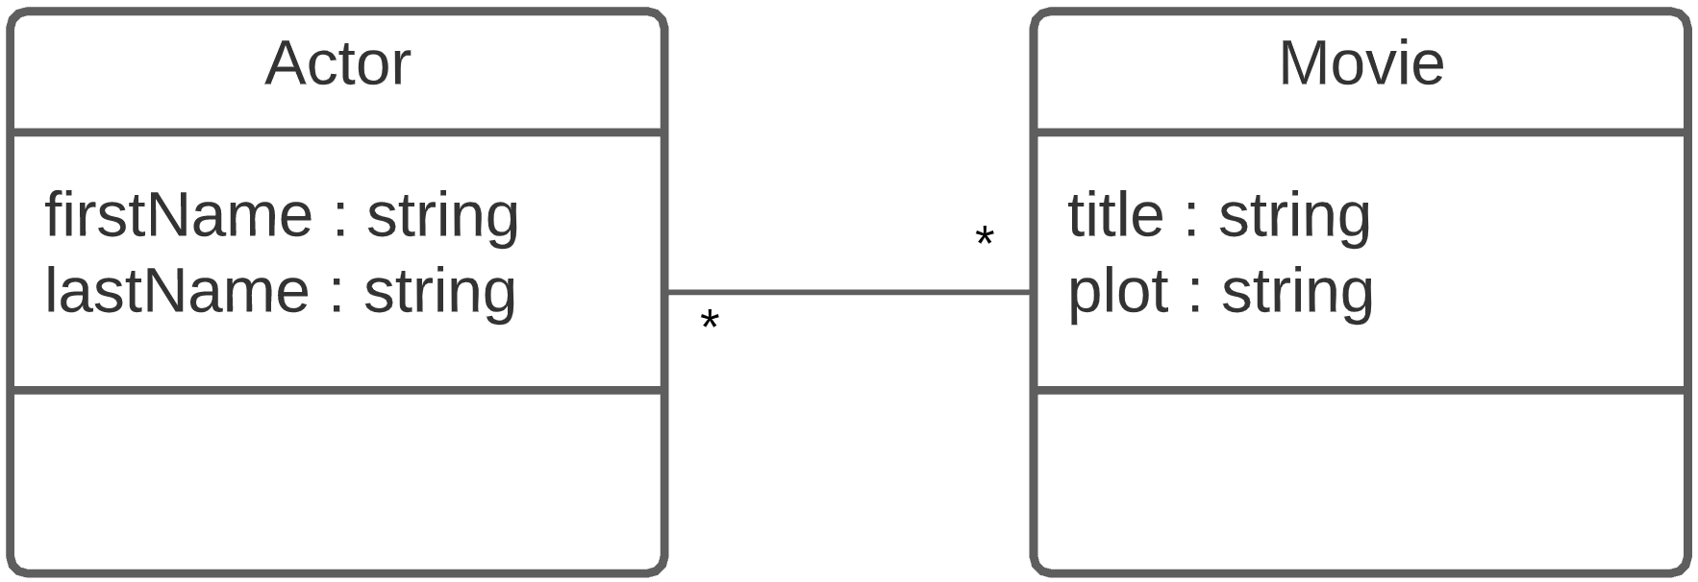
Audience
Consider the target audience and technology stack
Pure UML does not care on technology implementation
Consider the following many to many relationship
Note lack of keys and arrays already implied in association lines and multiplicity

Slide 30
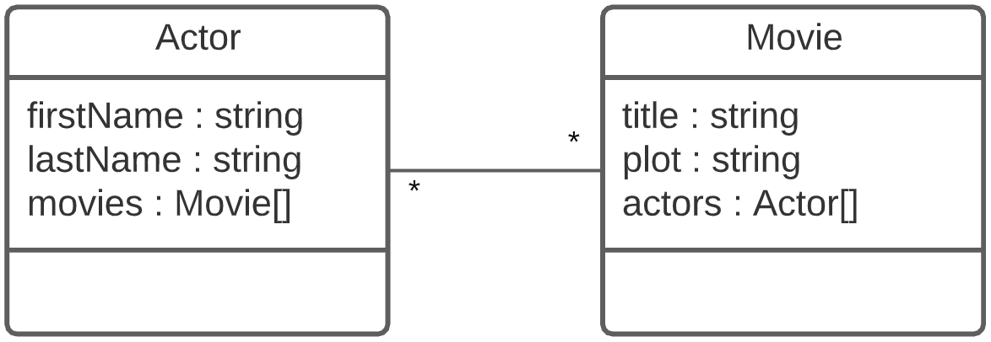
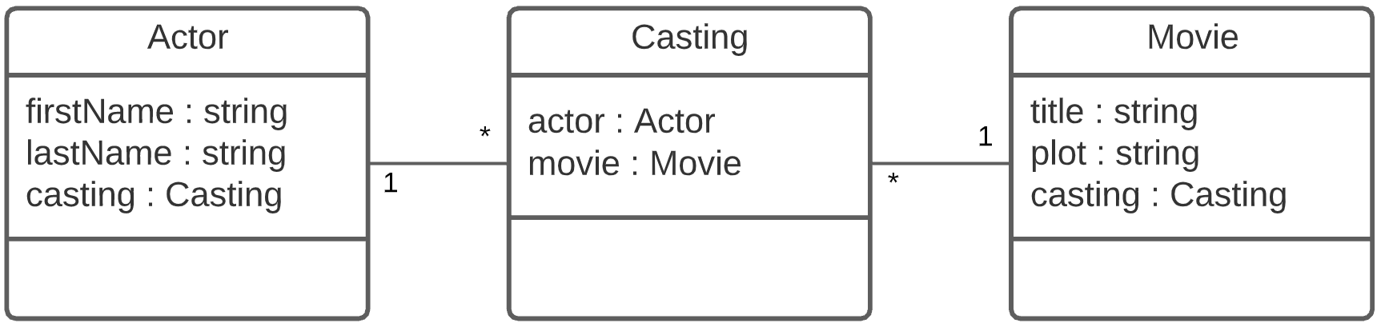
Same Diagram for Java/C# Audience
Implemented with arrays
Implemented with mapping class "Casting"

Slide 31
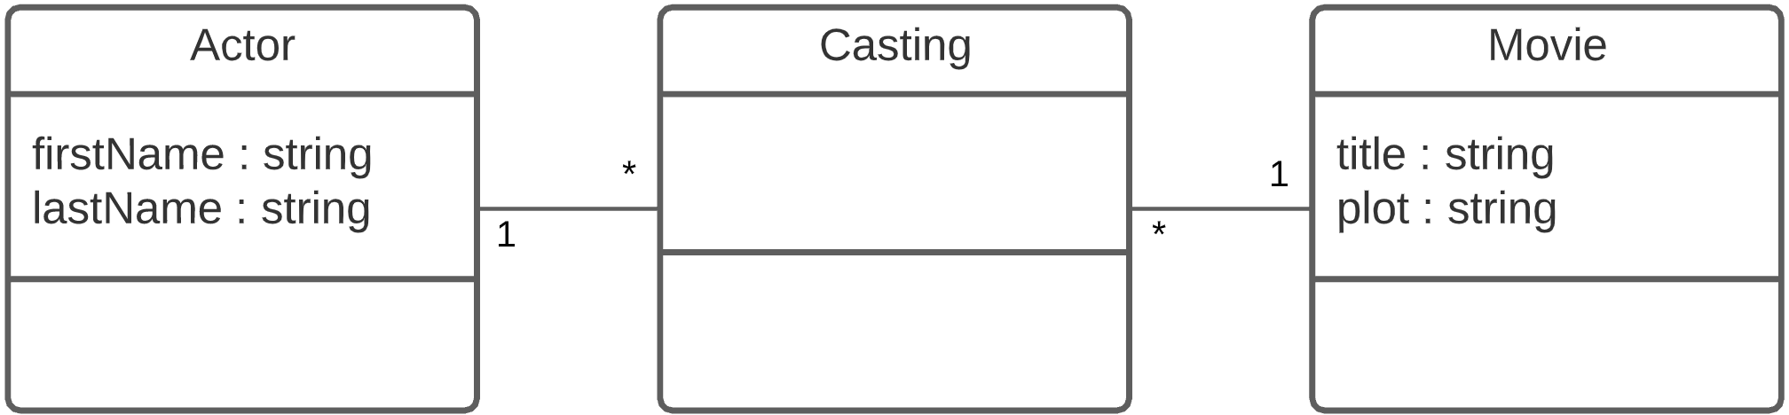
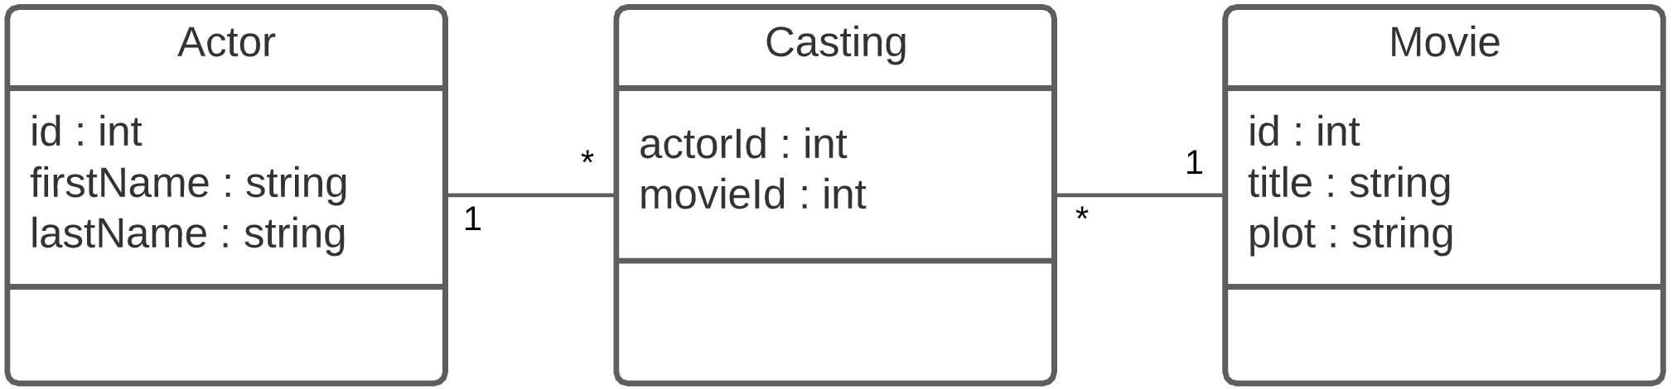
Same Diagram for SQL Audience
Reify w/mapping class. Keys implied by lines/multiplicity
Add primary and foreign keys for clarity if necessary

